Slide 1
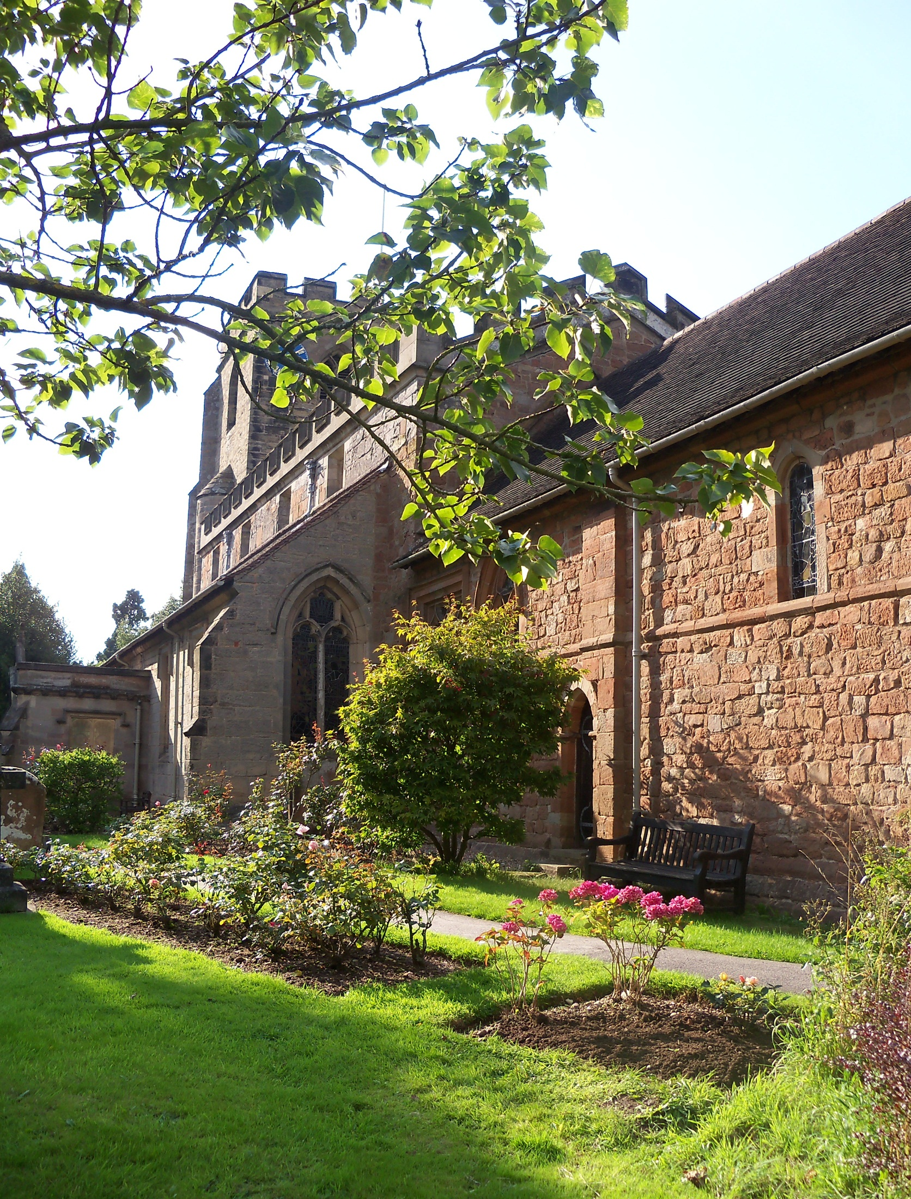
YOUR WEDDING
AT THE PARISH CHURCH OF ST. MARY
AND ST. BARTHOLOMEW HAMPTON-IN-ARDEN 2023

Slide 2
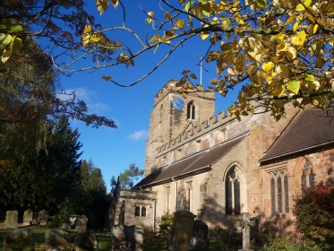
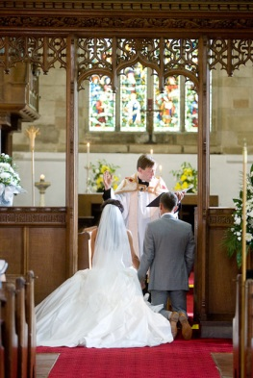
Congratulations on your forthcoming marriage!
Whether you're just dreaming of a church wedding, or well into the planning already, Hampton church wants to help and support you
The Parish Church of Hampton-in-Arden
is over 800 years old and sits on a hill in the conservation area within the village of Hampton-in-Arden near. Solihull. Surrounded by beautiful trees, shrubs and flowers, it's ancient churchyard provides a wonderful ambience of calm. Couples have been marrying in this church for hundreds of years.
We have a friendly congregation. We aim to make you feel comfortable and welcomed when you attend services. We have a play area at the back of church for young children and a Sunday School called Jesus and Me (J.A.M) which runs alongside our 11 am service in term time.

Slide 3
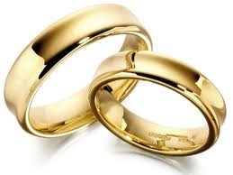
Some facts about Hampton Parish Church
We have seating for about 200 people.
We have toilet facilities (including disabled)
We have baby changing facilities.
The church is heated for winter weddings.
We can arrange ambient lighting in church if you so wish.
We have car-parking for about 20 cars
7. We have a church hall, suitable for small receptions, with a large kitchen and
toilets (with disabled facilities).
8. It is possible to walk through the woods to Hampton Manor from the
churchyard.
If you would like to know more about the church and it’s history or marrying at our church, please visit our website www.theparishchurchofhampton-in-arden.co.uk
If you plan to marry here and we have your contact details before it happens, you will be invited to a Wedding Preparation day with all the other couples marrying in the same year as yourselves. This will be on the nearest Saturday to Valentine’s Day in February so please make a note to come to it!
Our Vicar is Reverend Stuart Dimes,
.

Slide 4
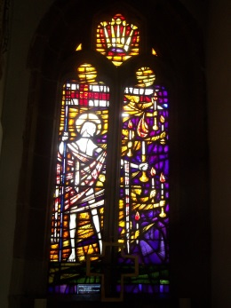
Our normal services are:
Sundays:
8.15 am. A quiet Holy Communion service
11 am. A Parish Communion service is held at this
time with the exception of the 1st Sunday in
the month which is a Family Service with no communion.
6.30 pm. We hold different services at this time each week. Please look on the home page of our website for more details.
Thursdays
10.00 am. A Holy Communion Service
Revd Stuart would be happy to speak to you about your wedding – do get in touch with him on revsdimes@live.com

Slide 5
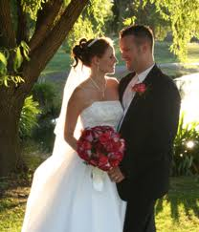
Preparing for marriage
Even if you have already been living together for some time, you are still two separate individuals with different backgrounds, personalities, experiences, hopes and fears.
You’ll never make such big promises to each other as the day you make your wedding vows. Your church knows that you will want to think these through and provides the time and space to do so. Ask about marriage discussions and what they offer to help you consider the vows together. To get you started, these are some of the key issues:
'All that I have I share with you'...How will we share our possessions and finances?
'Will you love, comfort, honour and protect (him/her)'...How will we cope with disagreements so that we will protect our love and respect for each other for a lifetime?
'Forsaking all others, be faithful as long as you both shall live’...How will we ensure we avoid and/or cope with temptations in order to remain faithful throughout our marriage?
'With my body I honour you' and 'all that I am I give to you'...How will we invest in our sexual relationship throughout our whole marriage?

Slide 6
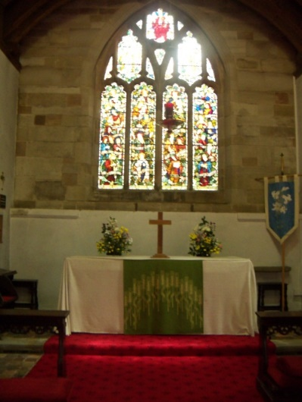
Special day, special place
We want to make your wedding personal
and memorable for you.
Churches are special places and there
are some things about a church wedding
that you just can’t get anywhere else.
A church wedding will add a spiritual dimension to your marriage. The ceremony includes God and looks to him for help and guidance. God’s blessing is the main attraction for many couples, whatever their beliefs.
You can make amazing vows, or promises, in a church. You can only make vows this big in a church. These vows, made in public, will help you to stay together and grow together. God and your church are there for you to help you keep your vows.
The person who takes your service has a very particular role to play in your wedding. He or she can blend ancient tradition and modern experience to reflect your story. Because of the relationship with him or her, your wedding can be made personal, memorable, meaningful and beautiful.
Church buildings can offer outstanding beauty and centuries of history. The Parish Church of St. Mary and St. Bartholomew in Hampton-in-Arden is a Grade 1 listed building and makes a stunning wedding venue. It is over 850 years old.
Imagine all the couples who have married there, some of whom may well be your family. You can feel you’re becoming part of history itself, the bigger plan, by marrying in the same place as your relatives or starting a new section of your own family history that can be continued by your children and their children.
For some people, a church simply seems like the proper place to get married. Churches can be described as 'peaceful', 'serene', or having an atmosphere that makes marrying there a particularly special experience. Where else can bells ring out and announce your marriage to the whole world?

Slide 7
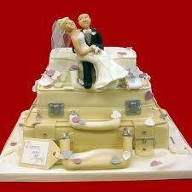
Planning your day:
If you would like to marry at Hampton-in-Arden Parish Church and you meet the criteria for couples who wish to marry here, as listed in this booklet; please get in touch with Reverend Stuart and he will put you in touch with our Administrator, Chris Cluley who will look after your queries etc. until you meet up with Revd. Stuart Dimes or Rev. Clare Dean about 4 months before your wedding to discuss details.
Revd. Stuart, or Revd. Clare, will officiate at your wedding and you will have plenty of opportunity to speak to them. If you have a special connection with a priest from another Parish, you may be able to obtain permission for him or her to take the service or part of it. Please speak to us if this is the case.
You can discuss all your arrangements and how we can make your day special for you when you have your meeting with either Revd. Stuart or Revd Clare, about 4 months before your wedding. But Chris can help you in the meantime, with any questions you might have.
Our Director of Music, Mr. Kim Rawson, who is also our organist and choir-master, will help you with all your music and will even go over your order of service with you if you would like him to do so.

Slide 8
To ensure the marriage complies with both UK Civil and Church law, there are certain aspects of a church wedding that must be fulfilled.
Proof of Identity
Changes in the law now require us to photocopy your passports before we can call your banns in our church. Once you have booked your wedding, please bring your passports in to be copied. The copies will be stored safely for as long as the law requires. You may also have to do this in your local church if you do not live in our Parish, before they can call your banns in that church. It will be your responsibility to check this.
Reading of Banns Banns are an announcement in church of your intention to marry and a chance for anyone to put forward a reason why the marriage may not lawfully take place.
Banns need to be read in the parish church where each of you lives as well as the parish church in which you are to be married, if that is somewhere else. If banns are not read in all relevant churches (and a banns certificate obtained from them and brought to us) then your wedding will not be allowed to go ahead, so it is very important!
You must have your banns read out in church for three consecutive Sundays; at Hampton-in-Arden church this is usually the first three Sundays of the month preceding your wedding month.
There must be enough notice given for the Banns to be read before the marriage is due to take place. Please note that if one or both of you are not British or if one or both of you do not live in Britain, then the procedure will differ slightly, please discuss this at your initial meeting with our Vicar or our Curate. If one or both of you do not hold a British or (EU passport up to the end of 2020), please speak with us
You must be old enough
If you are under 18 years old you will need your parents' consent to marry and by law you can not be married in the UK until you are 16.
Time of wedding To be legal the wedding must take place between 8am and 6pm on any day.

Slide 9
The cost of church weddings
There is no doubt that the choices you make about your wedding day can make a huge impact on the cost.
If you choose to marry in church, we want it to be a day that is personal and special for you, but that need not mean you spend a fortune.
At the current time, we aim to have just one wedding per day. You will know therefore that the time you spend at the church is special just to you, your family and friends and you can arrive at the church knowing there will not be another wedding party leaving, nor do you have to speed up the photographer or your guests after the service because there is another wedding party arriving. However, we would appreciate it if the bride is not late arriving at the church, in case our organist is playing for another wedding elsewhere.
There is a legal fee for marrying in a church. Please see this amount in the Hampton Parish Church costs for 2023 on the next page. This legal fee is set by the Church of England nationally. .
Local donation fees are charged to cover the running cost of the Church and include administration costs, Copyright licences for music and services, video licences, organ tuning and general running expenses such as heating, lighting and providing people on the day such as a Verger or another member of the church to help ensure it is a day you will remember with pleasure.
The fees for the organ, choir and bells are set by the individuals concerned and the church has no control over these. As far as we are aware the fees will be as in this booklet. The church only acts as an agency for these to be collected

Slide 10
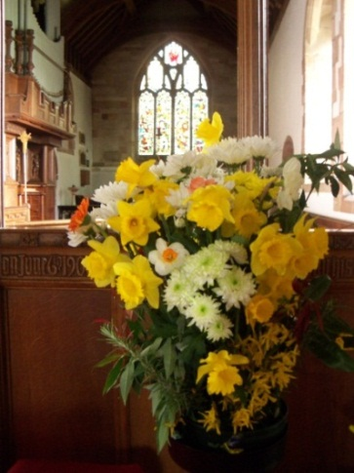
Listed below are the Statutory fees and local fees for your wedding at Hampton-in-Arden Parish Church for 2023. They may increase a little so please allow for this
An account will be sent to you one month before your wedding, for payment at least two weeks before.
We do not ask for a deposit. However, please understand that payment must be made in full before your wedding can take place as we have to pay fees in advance.
Legal and Statutory Fees | Payment to the Diocese – these fees are compulsory and are set each year by the Diocese. They include the wedding rehearsal and ceremony. | 564
Local Donation | A voluntary amount towards costs the church incurs for lighting, heating, maintenance and the administration that a wedding service requires | 220
Organist | We collect this fee on behalf of the organist and the church has no control over the cost. | 135
Choir | This is a contribution towards the volunteer choir’s time and costs and the cost of providing music. The church has no control over this cost. | 160
Bells | Again, this is a contribution towards the volunteer bell ringer’s time and travel costs. The church has no control over this cost. | 195
 | TOTAL WEDDING FEE | £1274

Slide 11
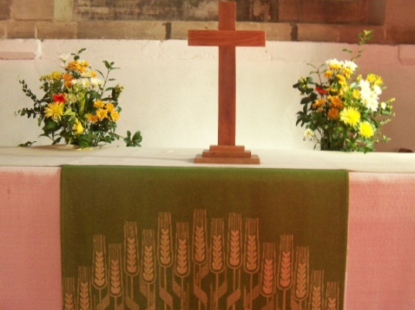
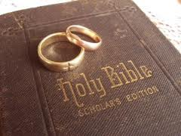
You can choose from three different marriage services:
A service from the Book of Common Prayer (1662) – in traditional language
A modified version of the Book of Common Prayer service, (1966) as one of the Alternative Services: Series One
The Marriage Service from Common Worship (2000) – in modern language, and reflecting the current Christian understanding of marriage
The Common Worship marriage service offers the most flexibility in the choice of readings and prayers, but in all three, you can be involved in choosing hymns and other music, for the service.
Reverend Stuart Dimes Email: revsdimes@live.com
Reverend Clare Dean Email: clare@evzone.co.uk
Parish Administrator: Email: chris.cluley1@gmail.com
Mr. Kim Rawson: Email: kim.rawson@btinternet.com

Slide 12
Readings: “And the greatest of these is love”
All weddings in the Church of England include one or more readings from the Bible. There are many popular and exciting passages to consider – please take a look together at the suggested readings in our readings booklet and see if what they say seems important to you. (You will be given a copy at the Wedding Preparation Day)
We would like you to have a religious reading as well, should you choose a non religious reading. .Please discuss your readings choice with Revd. Stuart or whoever is taking your wedding service.
May God be with you and bless you; May you see your children's children. May you be poor in misfortune, Rich in blessings, May you know nothing but happiness From this day forward.

Slide 13
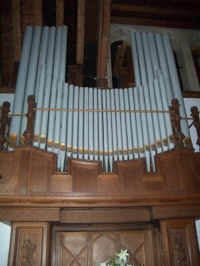
Music at your wedding is a very personal choice.
Our Director of Music and organist, Mr. Kim Rawson, will be able to advise you, whether you want a traditional wedding or something with a bit of a difference. The following may be helpful information to get you started. We will have copies of our Music booklet available at our Wedding Preparation Day for you to take home. Hymns There are usually two or three hymns sung during a wedding service. Try to find hymns that are familiar to your guests - and are easy to sing! Our choir will help to ensure the hymns are sung if your guests don’t know the tunes.
Or you might like to find hymns that have especially relevant words; again, Kim will be able to help. (You will be given a booklet listing the more common hymns and musical items for weddings at our Wedding Preparation Day
The Church Choir We have an “All Ages ” choir which can be present at your wedding and help lead the hymn singing. They can if you wish, sing a suitable piece by themselves during the service, such as when you are signing the Register. This is now a much shorter part of the service, but the choir would still be happy to sing music of your choice should you wish them to do so at this point. Please remember that if you have a weekday wedding in term-time, our junior choir will not be able to attend.

Slide 14
MUSIC (continued)
Processional Music To accompany the bride’s walk down the aisle, many couples still choose the traditional "Bridal March" by Wagner and Mendelssohn’s "Wedding March“ when you both leave the church. However, there is scope for other music, so if you would like to explore something different, please talk to Kim about this. It may even be possible to play recorded music, though wherever possible Kim would advise that “live” music always has the edge!.
Kim is very versatile, so ask him if you would like to walk in or out to non religious music. He will no doubt be happy to play it wherever possible.
++++++++++++++++++++++++++++++++++++++++++++++++++++
Orders of Service
You may be sending your requirements to the printers or you might be writing your own order of service. Our advice is to keep the font fairly large and “readable”. With a fair spread of age, wedding guests prefer an easy to read set of words for hymns etc. Chris our Administrator may be able to give you some examples of previous orders of service.

Slide 15
Flowers
Please ask whether we can help you with someone to arrange your flowers in church. You are free to use your own florist if you prefer.
Church flowers if done especially to your requirements will be arranged by our flower arrangers for a very reasonable charge.
Please remember that certain times in the year, the church will not have the normal flowers on the altars, such as Lent. You will need to ask if you wish to have flowers at these times. It is also recommended that you discuss any thoughts you have with our church florist about the type and placing of arrangements – it’s important that large floral arrangements don’t stand in the way of any proceedings during the service! Chris will give you a contact number if you would like to discuss special flowers in church. Bells We have a dedicated team of bell ringers. They would be delighted to ring the bells in celebration of your marriage as you leave the church after the service.
DVD recordings are a wonderful way to preserve the memories of your wedding day. The day flashes by and it is wonderful to be able to see it again over the years to come. We would ask that your photographer talks to whoever is taking the service to ensure that he or she knows where to stand and will be unobtrusive when taking videos or photos.
Special licences for recording are required, so please check with your photographer that they have the appropriate licences if any videos are to be taken.

Slide 16
Prayers at your Wedding
Quite simply, prayer is a conversation with God.
Christians believe that God listens to and acts on our prayers, and also communicates with us when we pray. Christians believe prayer is powerful enough to change us and our world for the better. When supporting you in something as important as marriage, your church will pray for you before, during and after your wedding. Before your wedding, you will arrange to have your banns read in your home church (nearest Parish Church) if this is in a different Parish from Hampton Church. The banns will also be read at Hampton. On these occasions, the whole church will pray for your forthcoming marriage and many couples like to be present to hear the banns called. It can be a moving and special occasion. On your wedding day, your service will certainly include prayers. We will be very happy to help you develop prayers that have special and personal meaning for you and your family, as well as using traditional prayers for marriage. It is possible for one of your guests to read prayers during the service. If this is something you would like to happen at your wedding, talk to us about how it could be incorporated.

Slide 17
Photographs
You will naturally want your special day captured by a photographer.
Talk to us about where your pictures might be taken, and particularly where photographs may be taken in the church during the service. Try to arrange for your photographer and Revd. Stuart/Revd Clare to meet up prior to the day of your wedding, so that these matters can be discussed.
Confetti
Is not allowed in our church grounds but may be thrown outside of the Lychgate at the entrance from the High Street to the churchyard. Please ask your guests to use bio-degradable confetti.
Wedding Preparation day : You will be invited to a Wedding Preparation day on a Saturday in February close to Valentine’s Day. In 2023 this is February 11th It will also give you an opportunity to talk with other couples marrying at Hampton, Bickenhill and Barston while having lunch and to fill in forms, look around the church, listen to the organ, choir and learn about the bells, ask questions etc.
Rehearsal
Most couples are reassured and enjoy the opportunity to rehearse their wedding service with family and friends who will be involved in the service. A rehearsal will be arranged as part of the preparations for your wedding. This might be a week before or a day before, but it gives you the opportunity to go through the service so that you and those taking part in the service know what to do and when and takes away some of the uncertainty that you don’t need on the day! Whoever is taking your wedding will speak to you to arrange a suitable time for a rehearsal and there will be a general rehearsal held at the Wedding Preparation Day too.

Slide 18
What is Marriage?
Marriage is a very ancient idea. The Bible suggests it goes right back to Adam and Eve, who were 'made for each other' (Genesis 2). Jesus' teaching on marriage, as exclusive, unbreakable and forging a new family unit, drew on this original blueprint. And Jesus loved a good wedding: he turned water into wine at a wedding reception (John 2), his first recorded miracle. Even today, marriage exists in practically every country and culture on earth.
So marriage has always been part of God’s good plan for us. And no wonder! A good marriage is healthy, freeing and life-giving.
Christians believe that marriage is a gift from God. There is something in a public commitment of this magnitude that has a spiritual element to it and which can transform a relationship to a new and deeper level.

Slide 19
You can marry in Hampton Church if you can show:- That one of you:
has at any time lived in the parish for a period of at least 6 months or was baptised in our parish or
was prepared for confirmation in our parish or
has at any time regularly gone to normal church services in this parish church (we suggest a period of at least 6 months and attendance at a service at least once a month ) or
That one of your parents, at any time after you were born:
has lived in the parish for a period of at least 6 months or
has regularly gone to normal church services in Hampton in Arden church for a period of at least 6 months or
That one of your parents or grandparents:
was married in the parish
If you have been divorced and would like to remarry in church, please chat to Revd. Stuart.
Hampton-in-Arden Parochial Church Council
Charity Number 1133937

Slide 20
We sincerely hope that you will continue to come to our church for services when you can after you are married here. We would be delighted to see you and hope that you will feel welcomed and at home in the place where you have taken your vows. We will need your permission to contact you after your wedding takes place, and we would like to let you know about special services and events being held at Hampton in Arden Church. We ask that if you do not want any further contact, you let Chris in the Church office know by the time you marry. Otherwise, we will assume you do not mind us using your email addresses to contact you in the future. Don’t forget to tell us if you move house or change your email address before or after your wedding date.
We wish you a wonderful wedding day and a life together filled with love for each other, patience, security, trust and laughter.
May God’s love and protection be with you both throughout your married life
For more information please visit our website: www.hamptoninardenchurch.org.uk

